Slide 1
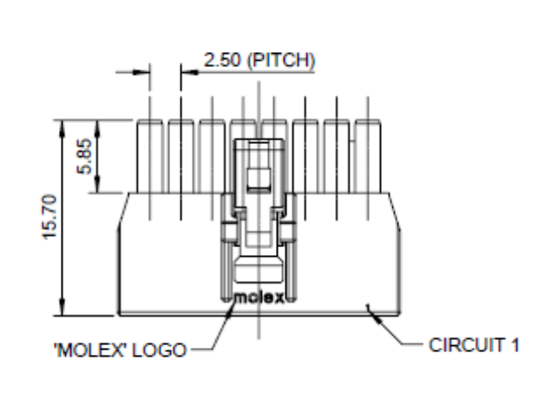
Looking into connector from male mating side.
Looking into connector from male mating side.
4
1
4
1
3
2
3
2
Beacon Board Serial#1
Female Connector
(LF10WBR-4S)
Beacon Board Serial#2
Female Connector (LF10WBR-4S)
CCT 1 – GND5
CCT 2 – GND4
CCT 3 – SERCOM2_RX
CCT 4 – SERCOM2_TX
CCT 1 – GND6
CCT 2 – GND
CCT 3 – SCK
CCT 4 – MOSI
Pin 1 - +3V3 [NOT POPULATED]
Pin 2 – RX (data into device)
Pin 3 – TX (data out of device)
Pin 4 - GND
Pin 1 - +3V3 [NOT POPULATED]
Pin 2 – RX (data into device)
Pin 3 – TX (data out of device)
Pin 4 - GND
Pin 2 - RX
CCT 3 – SERCOM2_RX
Pin 2 - RX
CCT 3 – SCK
Pin 3 – TX
CCT 4 – SERCOM2_TX
Pin 3 – TX
CCT 4 – MOSI
Pin 4 - GND
CCT 2 – GND4
Pin 4 - GND
CCT 2 – GND
All 3 Twisted Together
All 3 Twisted Together
Serial#1 : Instrument Daisy Chain
Serial#2 : iMET Radiosonde

Slide 2
Connecting Cable from Daisy Chain or iMET [NOT Included]
Looking into male connector from mating side.
Instrument TX
Pin 2
1
4
Instrument RX
Pin 3
2
3
Instrument GND
GND
TX/RX Crossover is in the cabling?

